Slide 1
Probability Concepts
(Part 3):
JPT Tables & Story/Scenario Problems

Slide 2
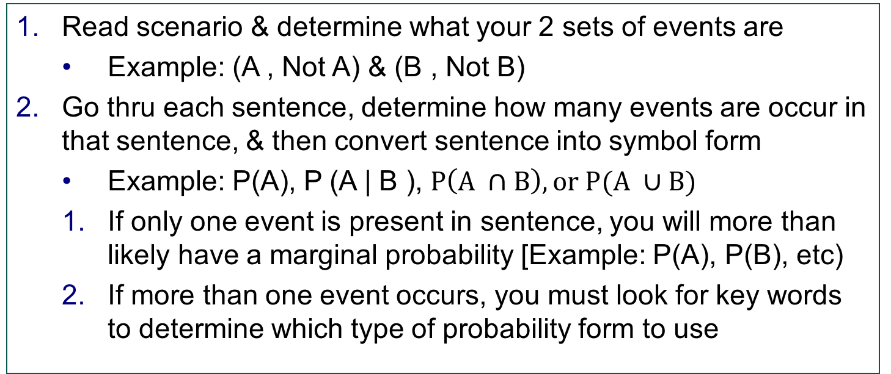
How to Solve a Story/Scenario Problem
Read scenario & determine what your 2 sets of events are
Example: (A , Not A) & (B , Not B)
Go thru each sentence, determine how many events are occur in that sentence, & then convert sentence into symbol form
Example: P(A), P (A | B ), $P\left(A ∩B\right), or P(A ∪B)$
If only one event is present in sentence, you will more than likely have a marginal probability [Example: P(A), P(B), etc)
If more than one event occurs, you must look for key words to determine which type of probability form to use

Slide 3
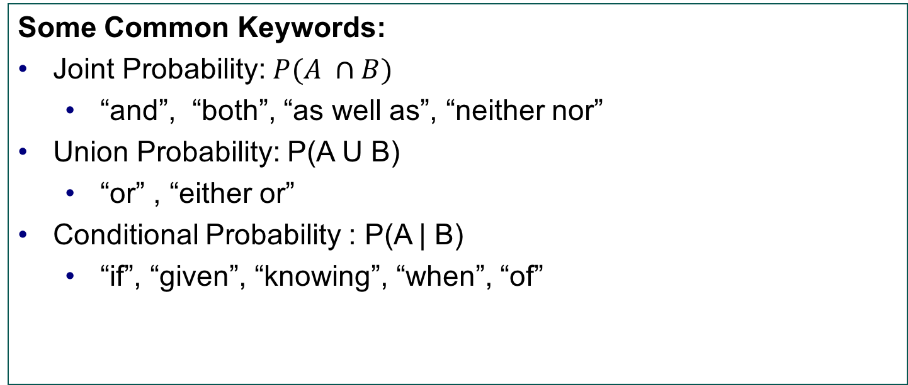
How to Solve a Story/Scenario Problem
Some Common Keywords:
Joint Probability: $P(A ∩B)$
“and”, “both”, “as well as”, “neither nor”
Union Probability: P(A U B)
“or” , “either or”
Conditional Probability : P(A | B)
“if”, “given”, “knowing”, “when”, “of”

Slide 4
How to Solve a Story/Scenario Problem
Once you have all your probabilities in the correct symbol form, use the formula sheet to try to find the probability asked for in the question
Particularly with conditional & union (“or”) probabilities, you may have to “break apart” your probability using the formula sheet to find the joint or marginal probabilities “hidden” within the formula
If you have “broken apart” all your conditional & union (“or”) probabilities, and you feel like you are “stuck”, its now time to create your JPT table

Slide 5
Probability Concepts
(Part 3):
In-Class Practice Problems

Slide 6
Scenario 1
A bagel shop in Boca reviewed its operations and determined the following: 80% of customers arrive in the morning. 50% of customers arrive in the morning and “Eat In” at the restaurant. 12% of the customers arrive in the afternoon and order food “To Go.”
Using this information, answer the following questions:
1. P(“Morning” and “Eat In”) = ?
2. P(“Morning” or “Eat In”) = ?
3. P(“Afternoon” or “To Go”) = ?
4. Of the “Morning” customers, what is the probability they order “To Go?
5. Are “To Go” and “Morning” independent?

Slide 7
Scenario 1 (Part 1)
A bagel shop in Boca reviewed its operations and determined the following: 80% of customers arrive in the morning. 50% of customers arrive in the morning and “Eat In” at the restaurant. 12% of the customers arrive in the afternoon and order food “To Go.”
Determine events & put sentences in symbol form

Slide 8
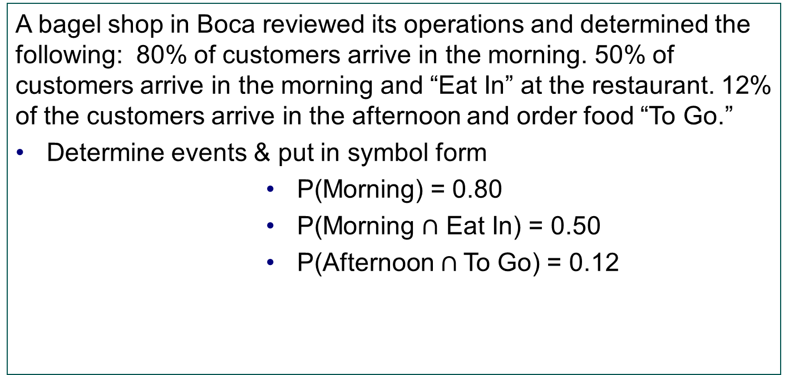
Scenario 1 (Part 1) Solutions
A bagel shop in Boca reviewed its operations and determined the following: 80% of customers arrive in the morning. 50% of customers arrive in the morning and “Eat In” at the restaurant. 12% of the customers arrive in the afternoon and order food “To Go.”
Determine events & put in symbol form
P(Morning) = 0.80
P(Morning $∩$ Eat In) = 0.50
P(Afternoon $∩$To Go) = 0.12

Slide 9
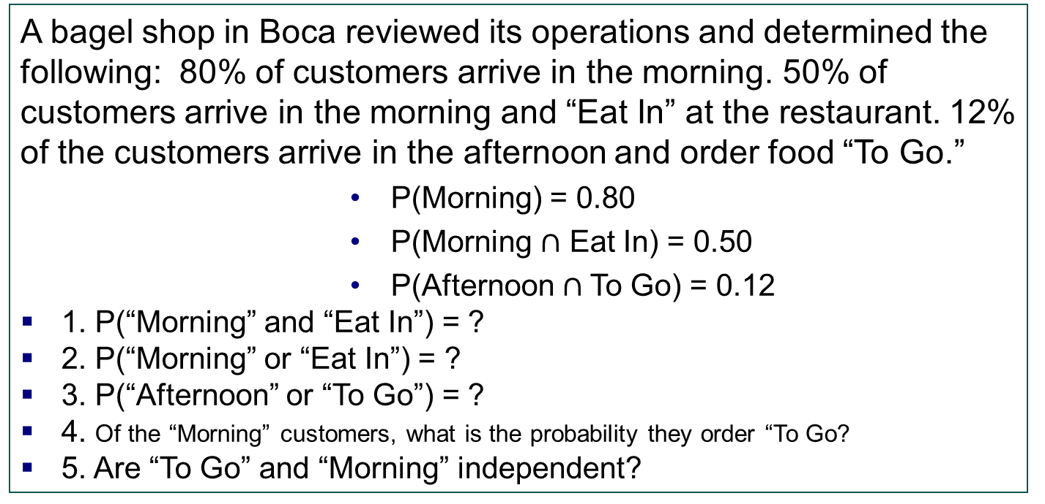
Scenario 1 (Part 2)
A bagel shop in Boca reviewed its operations and determined the following: 80% of customers arrive in the morning. 50% of customers arrive in the morning and “Eat In” at the restaurant. 12% of the customers arrive in the afternoon and order food “To Go.”
P(Morning) = 0.80
P(Morning $∩$ Eat In) = 0.50
P(Afternoon $∩$To Go) = 0.12
1. P(“Morning” and “Eat In”) = ?
2. P(“Morning” or “Eat In”) = ?
3. P(“Afternoon” or “To Go”) = ?
4. Of the “Morning” customers, what is the probability they order “To Go?
5. Are “To Go” and “Morning” independent?

Slide 10
Scenario 1 (Part 2) Solutions
A bagel shop in Boca reviewed its operations and determined the following: 80% of customers arrive in the morning. 50% of customers arrive in the morning and “Eat In” at the restaurant. 12% of the customers arrive in the afternoon and order food “To Go.”
You will quickly realize that we cannot answer the questions with the information we found.
Therefore, we have to create a JPT table since we are missing information to answer our questions.

Slide 11

Scenario 1 (Part 3)
P(Morning) = 0.80 Plug probabilities into table
$P\left(Morning ∩ Eat In\right)=0.50$
$P\left(Afternoon ∩ To Go\right)=0.12$

Slide 12

Scenario 1 (Part 3) Solutions
P(Morning) = 0.80
$P\left(Morning ∩ Eat In\right)=0.50$
$P\left(Afternoon ∩ To Go\right)=0.12$
 | Eat In | To Go
Morning | 0.50 | 0.30 | 0.80
Afternoon | 0.08 | 0.12 | 0.20
 | 0.58 | 0.42 | 1.00

Slide 13
Scenario 1: (Part 4)
 | Eat In | To Go
Morning | 0.50 | 0.30 | 0.80
Afternoon | 0.08 | 0.12 | 0.20
 | 0.58 | 0.42 | 1.00
1. P(“Morning” and “Eat In”) = ?
2. P(“Morning” or “Eat In”) = ?
3. P(“Afternoon” or “To Go”) = ?
4. Of the “Morning” customers, what is the probability they order “To Go?
5. Are “To Go” and “Morning” independent?

Slide 14
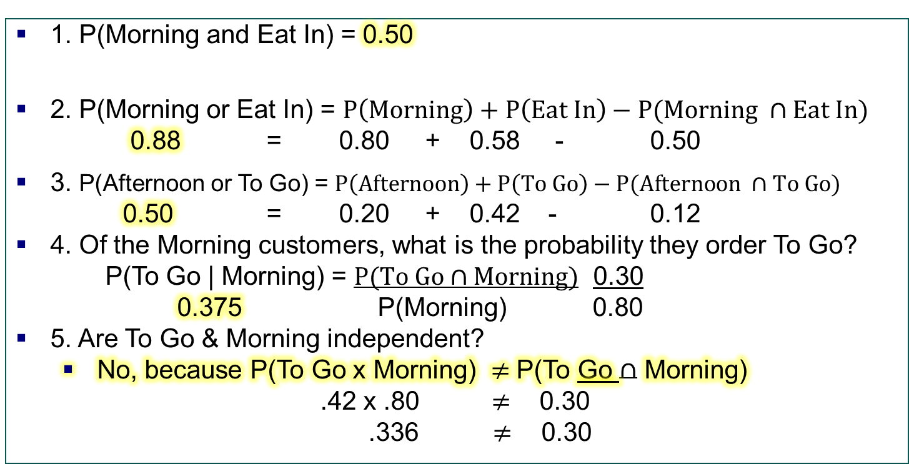
Scenario 1: (Part 4) Solutions
 | Eat In | To Go
Morning | 0.50 | 0.30 | 0.80
Afternoon | 0.08 | 0.12 | 0.20
 | 0.58 | 0.42 | 1.00
1. P(Morning and Eat In) = 0.50
2. P(Morning or Eat In) = $P\left(Morning\right)+P\left(Eat In\right)−P(Morning ∩Eat In)$
0.88 = 0.80 + 0.58 - 0.50
3. P(Afternoon or To Go) = $P\left(Afternoon\right)+P\left(To Go\right)−P(Afternoon ∩To Go)$
0.50 = 0.20 + 0.42 - 0.12
4. Of the Morning customers, what is the probability they order To Go?
P(To Go | Morning) = $P(To Go∩Morning)$ 0.30
0.375 P(Morning) 0.80
5. Are To Go & Morning independent?
No, because P(To Go x Morning) $≠$ P(To Go $∩$ Morning)
.42 x .80 $≠$ 0.30
.336$≠$ 0.30

Slide 15
Scenario 2:
A local car dealership buys and sells cars, but it makes most of it’s revenue from warranty purchases & servicing. The probability a customer will purchase a warranty is 20%. 60% of customer’s return to the dealership for servicing. If a customer has a warranty, the probability of returning for servicing is 80%.
Using the information above, answer the questions below:
1. P(Service and Warranty) =?
2. P(Warranty or Service) =?
3. If a customer returns for service what is the probability they have an extended warranty?
4. Of the customers with no warranty what is the probability they return for service?
Are Warranty & Service Independent?

Slide 16
Scenario 2: Part 1
A local car dealership buys and sells cars, but it makes most of it’s revenue from warranty purchases & servicing. The probability a customer will purchase a warranty is 20%. 60% of customer’s return to the dealership for servicing. If a customer has a warranty, the probability of returning for servicing is 80%.
Determine events & put sentences in symbol form

Slide 17
Scenario 2: Part 1 (Solution)
A local car dealership buys and sells cars, but it makes most of it’s revenue from warranty purchases & servicing. The probability a customer will purchase a warranty is 20%. 60% of customer’s return to the dealership for servicing. If a customer has a warranty, the probability of returning for servicing is 80%.
Determine events & put sentences in symbol form
P (Warranty) = 0.20
P (Service) = 0.60
P (Service | Warranty) = 0.80

Slide 18
Scenario 2: Part 2
P (Warranty) = 0.20
P (Service) = 0.60
P (Service | Warranty) = 0.80

Slide 19
Scenario 2: Part 2 (Solution)
P (Warranty) = 0.20
P (Service) = 0.60
P (Service | Warranty) = 0.80
 | Service | No Service
Warranty | 0.16 | 0.04 | 0.20
No Warranty | 0.44 | 0.36 | 0.80
 | 0.60 | 0.40 | 1.00

Slide 20
Scenario 2: Part 3
 | Service | No Service
Warranty | 0.16 | 0.04 | 0.20
No Warranty | 0.44 | 0.36 | 0.80
 | 0.60 | 0.40 | 1.00
P (Warranty) = 0.20
P (Service) = 0.60
P (Service | Warranty) = 0.80
1. P(Service and Warranty) =?
2. P(Warranty or Service) =?
3. If a customer returns for service what is the probability they have an extended warranty?

Slide 21
Scenario 2: Part 3
 | Service | No Service
Warranty | 0.16 | 0.04 | 0.20
No Warranty | 0.44 | 0.36 | 0.80
 | 0.60 | 0.40 | 1.00
4. Of the customers with no warranty what is the probability they return for service?
5. Are Warranty & Service Independent?

Slide 22
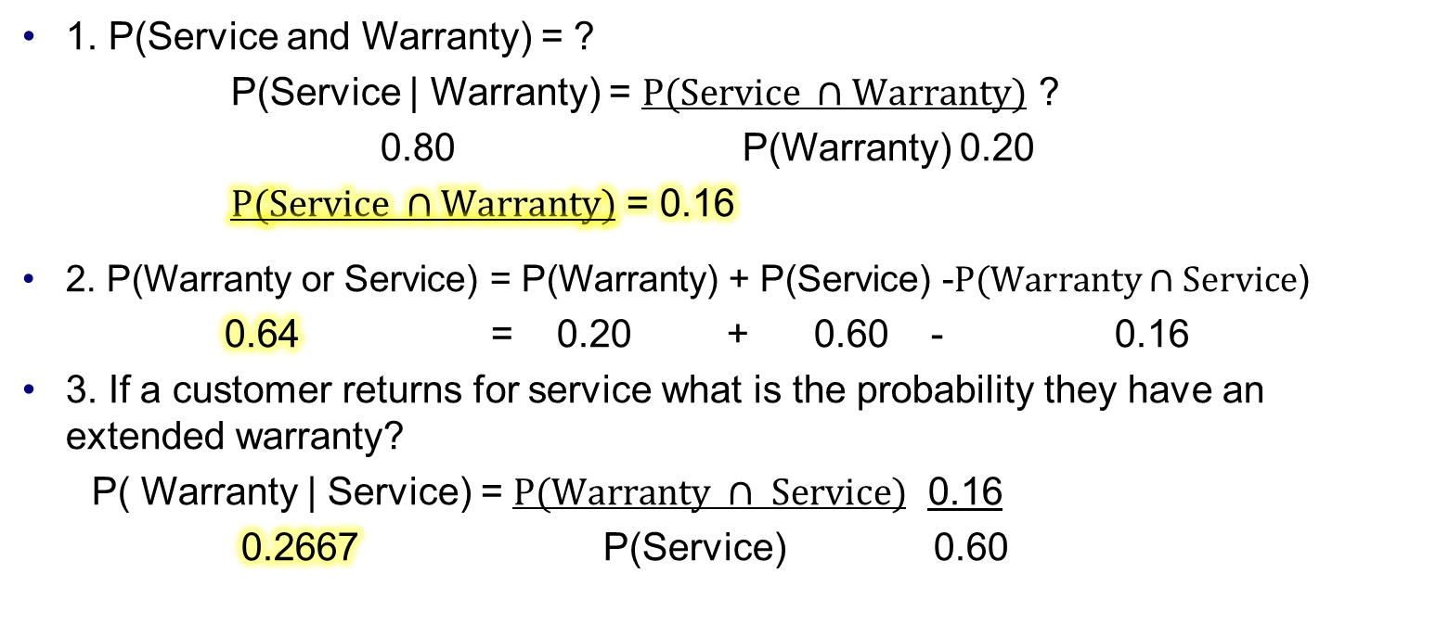
Scenario 2: Part 3 (Solution)
P (Warranty) = 0.20
P (Service) = 0.60
P (Service | Warranty) = 0.80
1. P(Service and Warranty) = ?
P(Service | Warranty) = $P(Service ∩Warranty)$ ?
0.80 P(Warranty) 0.20
$P(Service ∩Warranty)$ = 0.16
2. P(Warranty or Service) = P(Warranty) + P(Service) -$P(Warranty∩Service$)
0.64 = 0.20 + 0.60 - 0.16
3. If a customer returns for service what is the probability they have an extended warranty?
P( Warranty | Service) = $P(Warranty ∩ Service)$ 0.16
0.2667 P(Service) 0.60

Slide 23
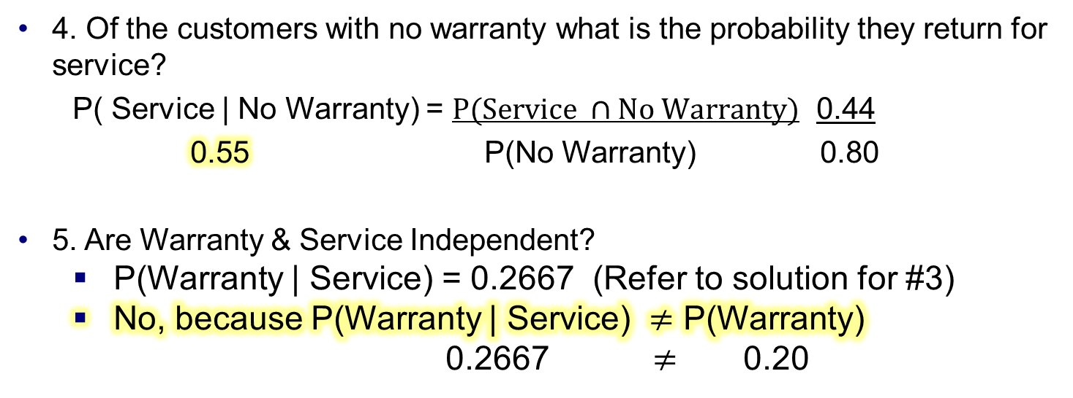
Scenario 2: Part 3 (Solution)
 | Service | No Service
Warranty | 0.16 | 0.04 | 0.20
No Warranty | 0.44 | 0.36 | 0.80
 | 0.60 | 0.40 | 1.00
4. Of the customers with no warranty what is the probability they return for service?
P( Service | No Warranty) = $P(Service ∩No Warranty)$ 0.44
0.55 P(No Warranty) 0.80
5. Are Warranty & Service Independent?
P(Warranty | Service) = 0.2667 (Refer to solution for #3)
No, because P(Warranty | Service) $≠$ P(Warranty)
0.2667 $≠$ 0.20

Slide 24
Scenario 3:
Three managers, Alex, Briana, and Charles work at a local restaurant. When closing, Alex closes the store 20% of the time, Briana closes the store 30% of the time, & Charles closes the store the remainder of the time. Occasionally, they forget to turn off the light to the storefront sign after work. When Alex closes, there is a 20% chance the storefront sign light is left on. If Briana closes, the chances the storefront light is left on is 40%. Lastly, given that Charles closes, there is a 60% chance that the storefront light is left on.
If the district manager notices the storefront light was left on last night, what is the probability that Charles was the one who closed the store?

Slide 25
Scenario 3: Part 1
Three managers, Alex, Briana, and Charles work at a local restaurant. When closing, Alex closes the store 20% of the time, Briana closes the store 30% of the time, & Charles closes the store the remainder of the time. Occasionally, they forget to turn off the light to the storefront sign after work. When Alex closes, there is a 20% chance the storefront sign light is left on. If Briana closes, the chances the storefront light is left on is 40%. Lastly, given that Charles closes, there is a 60% chance that the storefront light is left on.
If the district manager notices the storefront light was left on last night, what is the probability that Charles was the one who closed the store?

Slide 26
Scenario 3: Part 1(Solutions)
Three managers, Alex, Briana, and Charles work at a local restaurant. When closing, Alex closes the store 20% of the time, Briana closes the store 30% of the time, & Charles closes the store the remainder of the time. Occasionally, they forget to turn off the light to the storefront sign after work. When Alex closes, there is a 20% chance the storefront sign light is left on. If Briana closes, the chances the storefront light is left on is 40%. Lastly, given that Charles closes, there is a 60% chance that the storefront light is left on.
P(Alex) = 0.20, P(Briana) = 0.30, P(Charles) = 1 - (0.20+0.30) = 0.50
P( Light on | Alex) = 0.20
P( Light on | Briana) = 0.40
P( Light on | Charles) = 0.60

Slide 27
Scenario 3: Part 2
P(Alex) = 0.20, P(Briana) = 0.30, P(Charles) = 0.50
P( Light on | Alex) = 0.20
P( Light on | Briana) = 0.40
P( Light on | Charles) = 0.60
If the district manager notices the storefront light was left on last night, what is the probability that Charles was the one who closed the store?

Slide 28
Scenario 3: Part 2 (Solutions)
P(Alex) = 0.20, P(Briana) = 0.30, P(Charles) = 0.50
P( Light on | Alex) = 0.20
P( Light on | Briana) = 0.40
P( Light on | Charles) = 0.60
If the district manager notices the storefront light was left on last night, what is the probability that Charles was the one who closed the store?
P(Charles| Light on) = ?

Slide 29
Scenario 3: Part 3
P(Alex) = 0.20, P(Briana) = 0.30, P(Charles) = 0.50
P( Light on | Alex) = 0.20
P( Light on | Briana) = 0.40
P( Light on | Charles) = 0.60
P( Charles | Light on) = ?

Slide 30
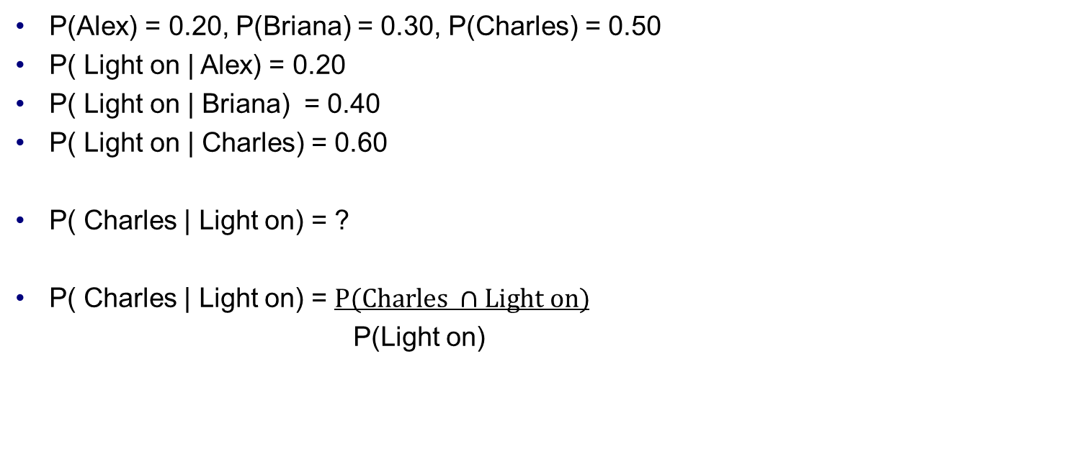
Scenario 3: Part 3 (Solutions)
P(Alex) = 0.20, P(Briana) = 0.30, P(Charles) = 0.50
P( Light on | Alex) = 0.20
P( Light on | Briana) = 0.40
P( Light on | Charles) = 0.60
P( Charles | Light on) = ?
P( Charles | Light on) = $P(Charles ∩Light on)$
P(Light on)

Slide 31

Scenario 3: Part 4
P(Alex) = 0.20, P(Briana) = 0.30, P(Charles) = 0.50
$P(Light on∩Alex)$ = 0.04
$P(Light on∩Briana)$ = 0.12
$P(Light on∩Charles)$= 0.30
P(Charles | Light on) = $P(Charles ∩Light on)$
P(Light on)

Slide 32
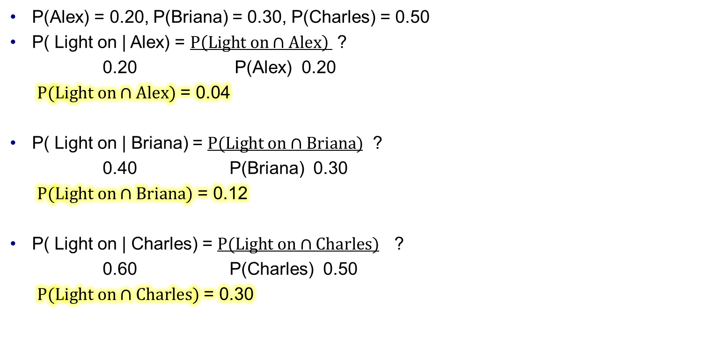
Scenario 3: Part 4 (Solution)
P(Alex) = 0.20, P(Briana) = 0.30, P(Charles) = 0.50
P( Light on | Alex) = $P\left(Light on∩Alex\right)$ ?
0.20 P(Alex) 0.20
$P(Light on∩Alex)$ = 0.04
P( Light on | Briana) = $P(Light on∩Briana)$ ?
0.40 P(Briana) 0.30
$P(Light on∩Briana)$ = 0.12
P( Light on | Charles) = $P(Light on∩Charles)$ ?
0.60 P(Charles) 0.50
$P(Light on∩Charles)$ = 0.30

Slide 33
Scenario 3: Part 4 (Solution)
P(Alex) = 0.20, P(Briana) = 0.30, P(Charles) = 0.50
$P(Light on∩Alex)$ = 0.04
$P(Light on∩Briana)$ = 0.12
$P(Light on∩Charles)$= 0.30
P(Charles | Light on) = $P(Charles ∩Light on)$
P(Light on)
 | Alex | Briana | Charles
Light on | 0.04 | 0.12 | 0.30 | 0.46
Light off | 0.16 | 0.18 | 0.20 | 0.54
 | 0.20 | 0.30 | 0.50 | 1.00

Slide 34

Scenario 3: Part 5
P(Charles | Light on) = $P(Charles ∩Light on)$
P(Light on)
 | Alex | Briana | Charles
Light on | 0.04 | 0.12 | 0.30 | 0.46
Light off | 0.16 | 0.18 | 0.20 | 0.54
 | 0.20 | 0.30 | 0.50 | 1.00

Slide 35
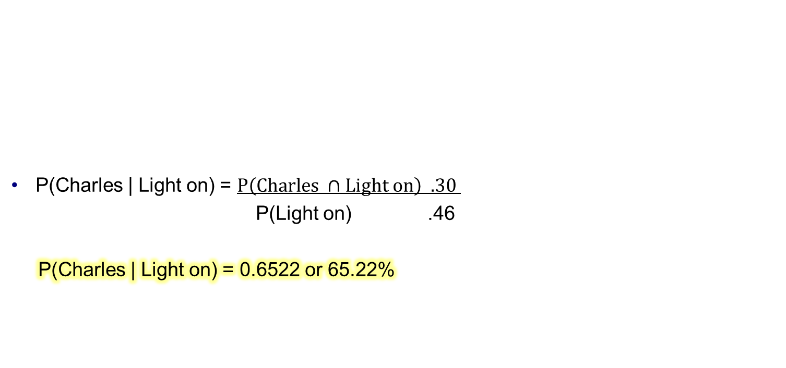
Scenario 3: Part 6 (Solution)
P(Charles | Light on) = $P\left(Charles ∩Light on\right) .30$
P(Light on) .46
P(Charles | Light on) = 0.6522 or 65.22%
 | Alex | Briana | Charles
Light on | 0.04 | 0.12 | 0.30 | 0.46
Light off | 0.16 | 0.18 | 0.20 | 0.54
 | 0.20 | 0.30 | 0.50 | 1.00

